Slide 1


Academic Research Online Agent System (AROAS): Critical Design & Evaluation

Slide 2
Introduction and Problem Signiﬁcance
Global scholarly output has expanded rapidly, intensifying discovery costs and increasing the risk that researchers overlook salient studies. Industry analyses report sustained annual growth in article volumes in the mid-single digits (≈5–6.5% p.a. 2015– 2020), alongside a marked structural shift toward open access (OA gold share rising from 11% in 2013 to 38% in 2023), which diversifies sources but fragments retrieval pathways (STM, 2021; STM, 2024).
AROAS addresses this by operationalising a multi-agent architecture to automate acquisition, normalisation and ranking, thereby improving early precision while embedding governance primitives. The design explicitly applies Multi-Agent Systems (MAS) principles—autonomy, social ability, and decentralised control—to decouple concerns and localise failure, and Information Retrieval (IR) principles—indexing and TF-IDF ranking—to deliver auditable, explainable relevance signals under tight module timelines (Wooldridge, 2009; Manning, Raghavan & Schütze, 2008). (STM Association, 2021; STM Association, 2024; Wooldridge, 2009; Manning et al., 2008). (journals.indexcopernicus.com)

Slide 3
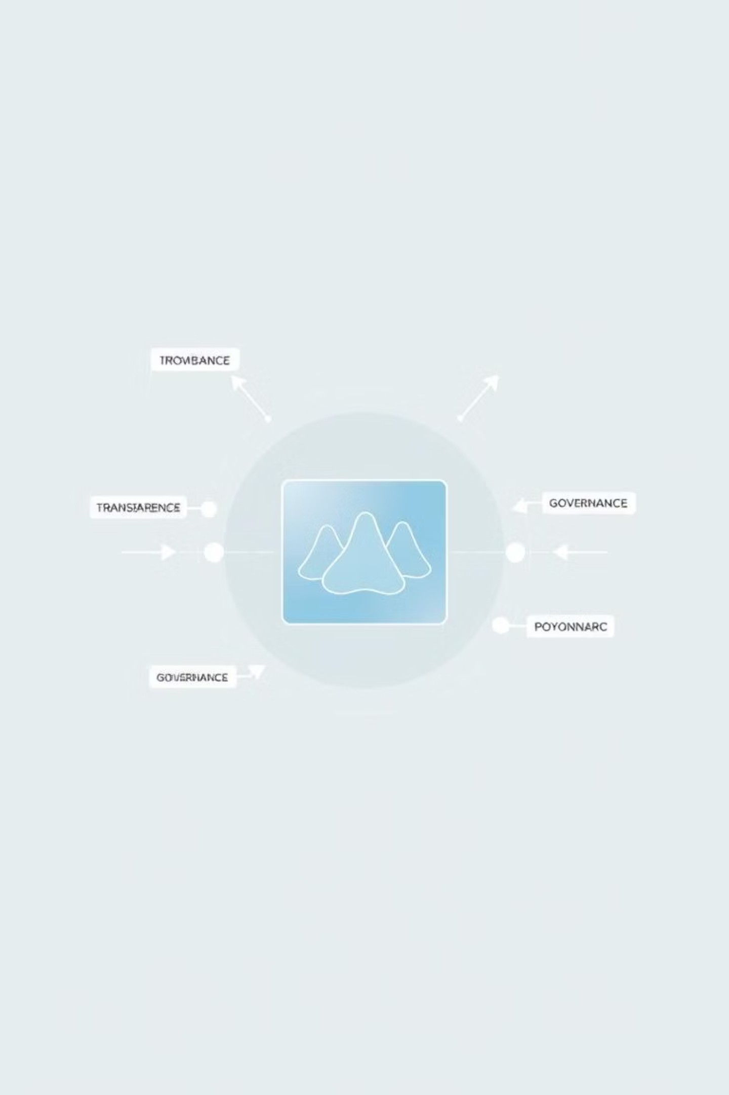
Addressing Quality and Ethical Risks
While growth statistics motivate automation, volume alone is not synonymous with value; concerns about saturation, predatory outlets, and retractions have intensified, indicating a need for systems that privilege transparency and provenance over “black-box” retrieval (The Guardian, 2025).
AROAS therefore foregrounds explainability (TF–IDF feature weights; auditable pipelines) and governance (robots/GDPR) to mitigate quality noise and ethical risk while preserving recall (Manning et al., 2008; RFC 9309; ICO, 2023). (The Guardian, 2025; Manning et al., 2008; RFC
Editor, 2022; ICO, 2023). (The Guardian)

Slide 4
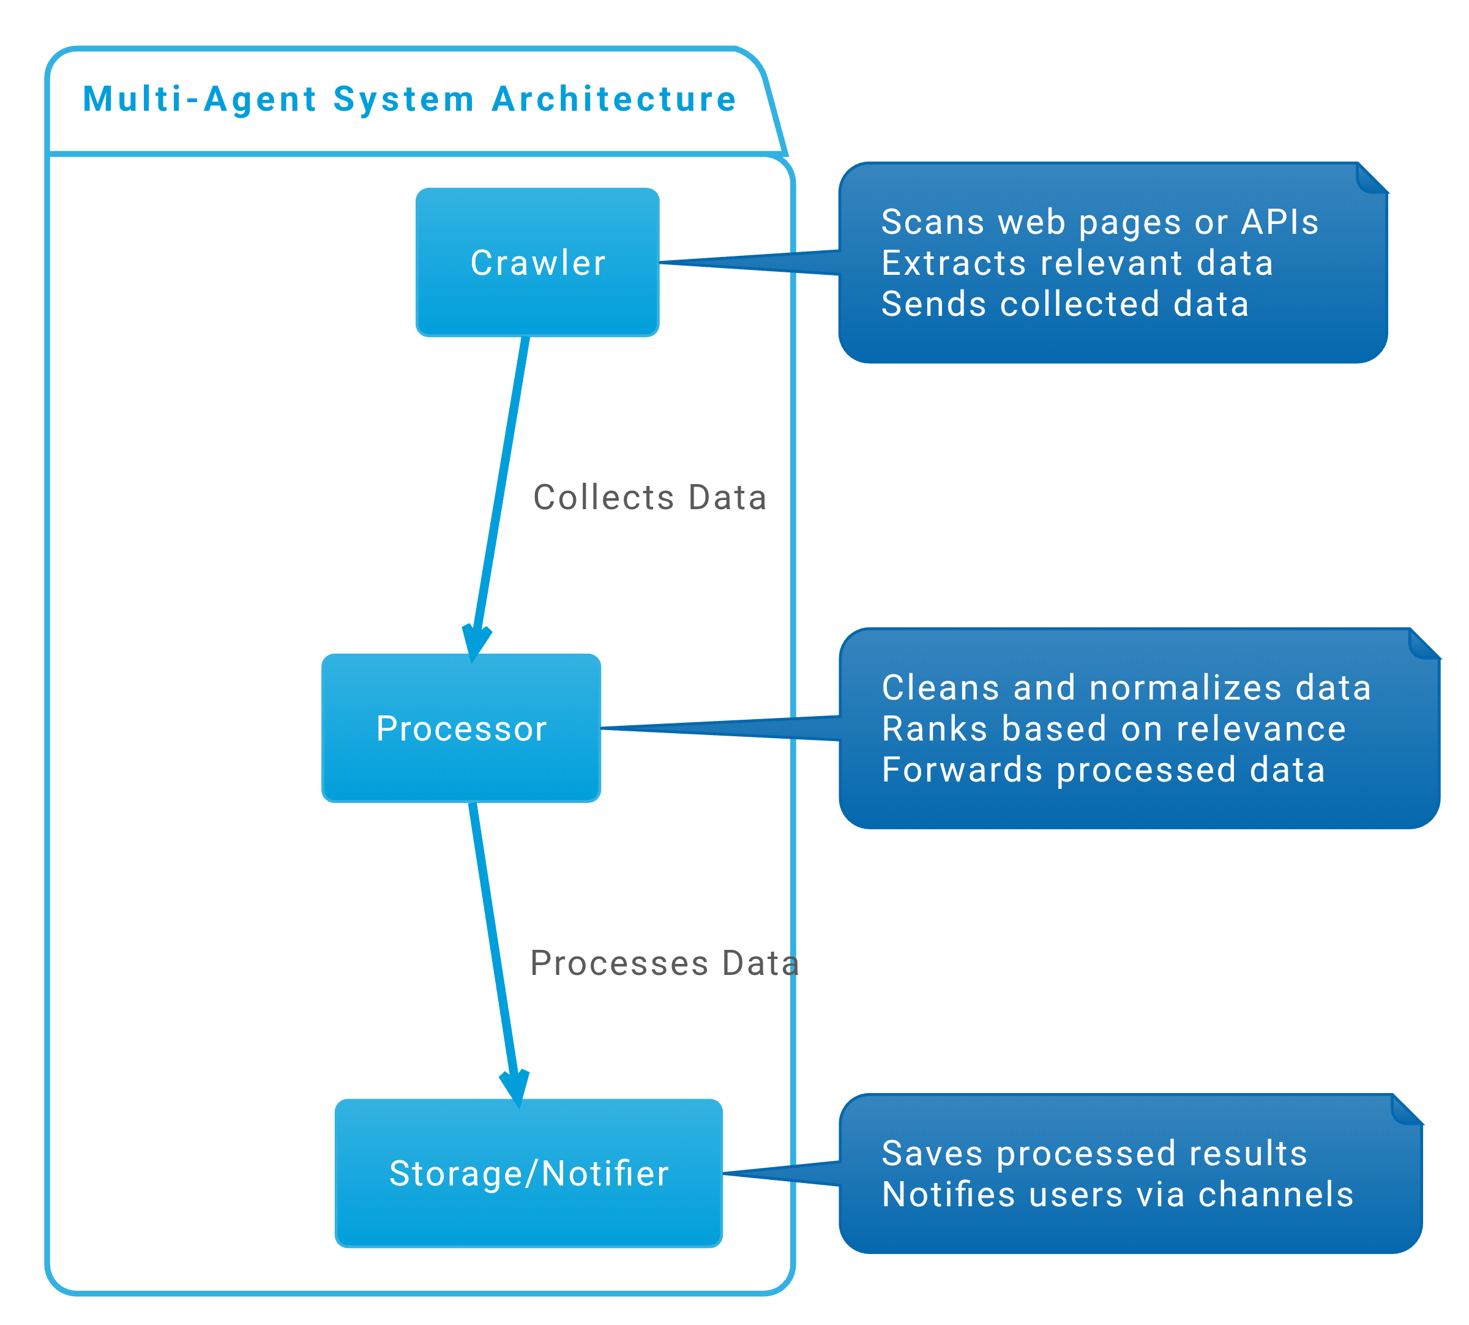
Theoretical Framing and Design Choice
MAS Decomposition
A tri-agent design—Crawler, Processor, Storage/Notifier—maps to MAS theory: competence distribution reduces global complexity and allows domain-specific optimisation (e.g., politeness in crawling versus CPU-bound text modelling). Coordination is handled via lightweight publish/subscribe channels. Under the CAP theorem, AROAS treats the messaging plane as AP (available during partitions, ephemeral delivery acceptable) and the persistence boundary (DB/object store) as CP (consistency prioritised), thereby confining inconsistency to transient signalling while guaranteeing durable state consistency (Gilbert & Lynch, 2002; Redis Docs). This trade-off is appropriate for recomputable events (crawl/score), and the idempotent hand-offs ensure eventual convergence. (Gilbert & Lynch, 2002; Redis, 2025). (DuckDB)
IR Baseline and Explainability
AROAS adopts TF–IDF for initial ranking because it delivers stable, interpretable gains on short scholarly fields (titles/abstracts) and supports reproducible audits by markers, whereas neural rerankers (e.g., BERT) often require GPUs and introduce stochasticity; empirical work shows classical methods remain competitive on many document- ranking tasks and are cost-efficient for baselines (Manning et al., 2008; scikit-learn, 2025). The system is architected to add neural reranking later without jeopardising assessment transparency (phased complexity). (Manning et al., 2008; scikit-learn, 2025). (Medium)

Slide 5
Software Stack: Selection with Evidence and Critique
Acquisition Layer
Dynamic Rendering
Parsing & Normalisation
Scrapy provides adaptive throttling (AutoThrottle) that modulates throughput according to site and spider load; this reduces HTTP 429s and improves crawl politeness without hand-tuning, a critical property when interacting with heterogeneous scholarly platforms (Scrapy, 2024/2025). Compared with ad-hoc loops, Scrapy’s scheduler, middlewares and per-domain concurrency caps yield more stable long-running crawls. Limitation: Twisted-centric design raises the entry barrier for novices, which AROAS mitigates with predefined templates. (Scrapy Project, 2024–2025). (docs.scrapy.org)
Selenium is restricted to domains with demonstrable client-side hydration, using explicit waits (`WebDriverWait`) to poll for
Beautiful Soup (over `lxml`) is used to extract established scholarly meta-tags (e.g., `citation_title`, `citation_author`)
semantic conditions rather than brittle
and clean boilerplate that would otherwise pollute vocabularies and skew term weights; this improves index quality for TF–IDF downstream (Beautiful Soup, 2024). (Richardson, 2024). (Medium)
sleeps; this practice is documented to reduce flakiness
and timeout The cost is
errors higher
(Selenium, 2025).
overhead, so AROAS gates Selenium by domain and page type to control latency and resource use. (Selenium, 2025). (Selenium)

Slide 6
Software Stack: Continued
Vectorisation & Ranking
Graph Features
Persistence & Analytics
scikit-learn’s `TfidfVectorizer` deterministic, testable ranking
affords
with
NetworkX provides centrality metrics (degree, betweenness, eigenvector) to enrich ranking where author networks matter; used on pruned top-N sets, it adds context without prohibitive
SQLAlchemy 2.0 standardises ORM patterns across SQLite (dev) and PostgreSQL (prod). For analytical exports, AROAS writes Apache Parquet to cut storage and scan costs: columnar reads frequently achieve multi-fold speed-ups (reported ranges from
≈2× to ≳10× vs compressed CSV in public
benchmarks), and 2–5× size reductions, which matters because services like Athena bill per byte
adjustable n-grams and stop-lists; its performance on short texts and transparency
of weights strengthens academic auditability. Critical note: while neural
encoders can lift semantic recall, their gains must be balanced against compute, reproducibility, and explainability in assessed coursework (scikit-learn, 2025; Manning et al., 2008). (scikit-learn, 2025; Manning et al., 2008). (Selenium)
memory growth (NetworkX, (NetworkX, (journals.indexcopernicus.com)
2025).
2025).
scanned (Edge Delta, 2025; AWS blogs/StackOverflow exemplars). Caveat: vendor and community benchmarks vary by workload; AROAS
therefore accompanies claims with reproducible evidence packs (SQLAlchemy, 2025; Edge Delta, 2025; AWS/StackOverflow exemplars 2017–2023). (SQLAlchemy)

Slide 7
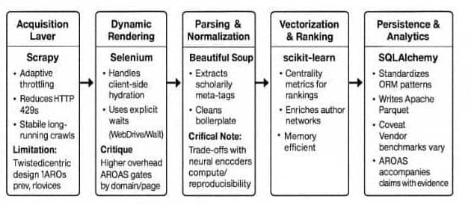


Slide 8



Governance, Compliance, and Integrity
Robots and Lawful Access
Data Minimisation (GDPR Art. 5(1)(c))
Academic Integrity
enforces the Robots Exclusion Protocol (REP) as
Each artefact carries a provenance bundle (task-id, timestamps, content hashes, source URIs). This supports reproducibility for seminars and viva and protects against integrity risks
The crawler
The system applies a “negative-list” to exclude personal data and processes only
formalised in RFC 9309; while REP is not an authorisation mechanism, it is
bibliographic fields necessary for discovery— adequate, relevant, and limited—thereby
an established social contract that ethical crawlers honour. AROAS
satisfying data-minimisation principles (ICO,
2023). Cloud tokens follow OAuth 2.0 Security Best Current Practice (RFC 9700), using short-lived credentials and PKCE where applicable (IETF, 2025). (ICO, 2023; IETF,
2025). (ico.org.uk)
amidst reported increases in low- quality or manipulated outputs (The Guardian, 2025). (The Guardian)
resolves and caches `robots.txt` per domain and records policy decisions
for audit (RFC Editor, 2022). (rfc- editor.org)

Slide 9
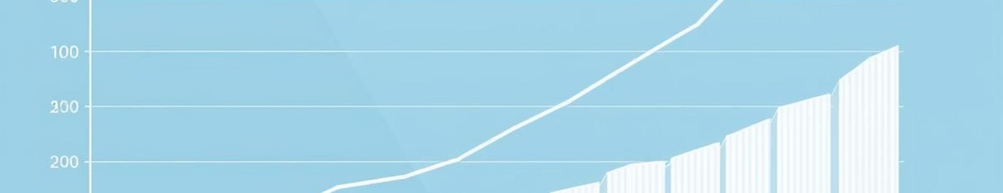
Empirical Context & Market Signals
The scholarly communication market measured about US$12.65 bn in 2022 (+2.7% y/y), with online content ≈30% and growing ≈7% y/y, highlighting the centrality of digital discovery and analytics (Simba/STM Publishing News, 2024).
OA expansion is also material: OA gold share rose from 11% to 38% (2013→2023), reducing paywalled dominance from 70% to 52%, which both widens access and increases heterogeneity in discovery endpoints (STM OA Dashboard, 2024). These statistics strengthen the business case for multi-source, policy-aware crawlers like AROAS (Simba/STM Publishing News, 2024; STM, 2024). (Simba/STM Publishing News, 2024; STM Association, 2024). (stm-publishing.com)

Slide 10

Methodology and Assessment Alignment
A three-sprint cadence (acquire → normalise/rank → persist/notify) aligns with assessment artefacts: each sprint yields verifiable outputs (crawl logs with robots decisions; TF– IDF weight tables; Parquet exports plus CSV samples). CI runs unit tests for tokenisation/meta-extraction and an end-to-end “query→top-K→export” scenario. This method privileges repeatability: containerised environments (Docker) fix runtime variance, which examiners can independently reproduce (Merkel, 2014). The critique is Selenium flakiness; AROAS counters with explicit waits and domain gating (Selenium, 2025). (Merkel, 2014; Selenium, 2025). (direct.mit.edu)
Risk Analysis and Mitigations
Dynamic Content and Anti-Automation Cost and Scale
Full-text hoarding
Quality Noise
is expensive and often
With rising volumes and publisher incentives, noise and low-quality outputs are non-trivial risks. AROAS therefore couples lexical ranking with lightweight graph features (co-authorship
Client-side hydration and anti-bot mechanisms can degrade recall. AROAS uses explicit waits for semantic conditions (e.g.,
unnecessary: AROAS stores normalised metadata plus legal pointers and exports Parquet for analytical workloads. Public and vendor benchmarks report 2×– 10× (and sometimes higher) scan-time improvements over CSV for OLAP-style queries,
presence of `meta[name=\”citation_title\”]`)
centrality) to surface intersections, while
hubs and authoritative keeping the rationale
and falls permitted, (Selenium,
back to first-party APIs when balancing coverage and ethics
and 2×–5× storage reductions; nevertheless, performance is workload-dependent, so the submission includes reproducible benchmarks (Edge Delta, 2025; Cloudera/Allstate, 2016). (Edge Delta,
2025; Cloudera, 2016). (Edge Delta)
auditable (NetworkX, 2025; The Guardian, 2025). (NetworkX, 2025; The Guardian, 2025). (journals.indexcopernicus.com)
2025; RFC 9309). (Selenium,
2025; RFC Editor, 2022). (Selenium)

Slide 11
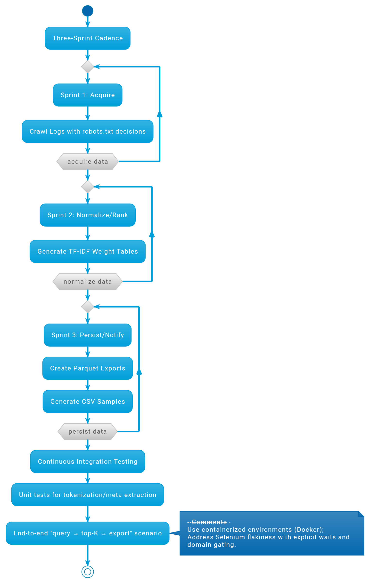

Slide 12
Comparative Justiﬁcation
1
2
3
Scrapy vs Bespoke Loops
Scrapy’s AutoThrottle adaptively optimises polite speed given site/server
TF–IDF vs Neural Rerankers (BERT)
Parquet vs CSV
Columnar storage reduces I/O by scanning only selected columns and compresses efficiently, which translates into lower query costs in engines that bill per byte scanned (e.g., Athena). Reported improvements commonly range from 2× to
≳10× speed-ups, but AROAS treats these as hypotheses to be validated in its evidence
For a 20-minute demo and independent marking, TF–IDF’s deterministic weights and small-footprint compute make it the correct starting point; neural gains can be
conditions; bespoke loops struggle to
replicate engineering
this without significant and often omit REP
and
layered once examined. This
baseline mirrors IR baselines are
validity is
enforcement—raising ethical
reliability risks (Scrapy, 2024/2025). For assessed work, institutional credibility
pedagogy required
where classical
before advanced models (Manning et al., 2008; scikit-learn, 2025). (Manning et
al., 2008; scikit-learn, 2025). (Medium)
pack to avoid over-generalising vendor claims (Edge Delta, 2025; AWS Big Data Blog exemplars). (Edge Delta, 2025; AWS Big Data Blog/StackOverflow exemplars). (Edge Delta)
and reproducibility justify Scrapy’s opinionated stack. (Scrapy Project, 2024– 2025). (docs.scrapy.org)

Slide 13
Conclusion
AROAS solves the growing challenge of scattered research data through a clean, tri-agent design—Crawler, Processor, and Storage/Notifier—that splits tasks, limits failure, and stays reproducible. Using TF–IDF ensures fast, explainable ranking suited for academic assessment, while the stack—Scrapy, Selenium, Beautiful Soup, scikit-learn, and SQLAlchemy—balances reliability with transparency.
Governance is built-in: AROAS respects robots.txt, limits personal data, and tracks every process for audit. The workflow, organized in three sprints, delivers verifiable results and repeatable builds.
Overall, AROAS provides a clear, ethical, and testable foundation for automated research discovery, ready for future upgrades like neural rerankers or advanced graph analysis.

Slide 14
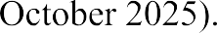
References

Slide 15
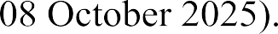

Slide 16
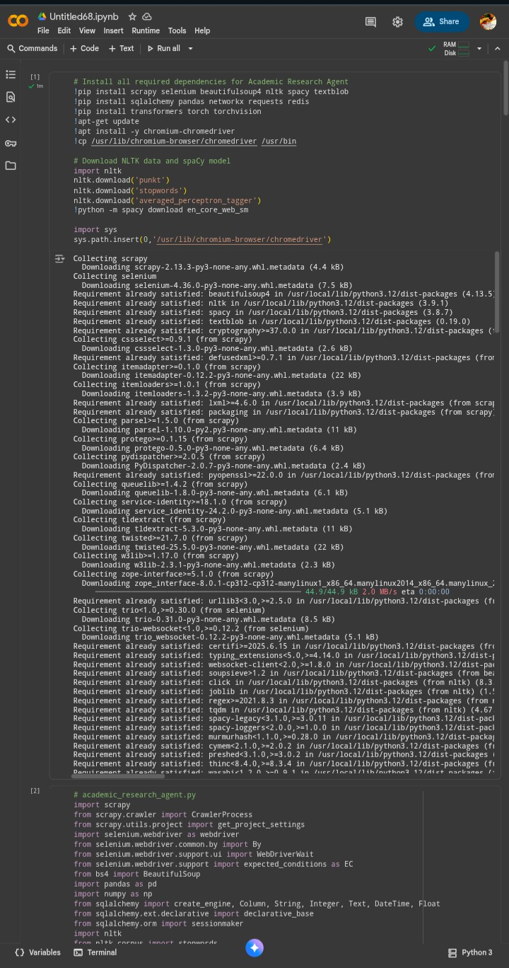
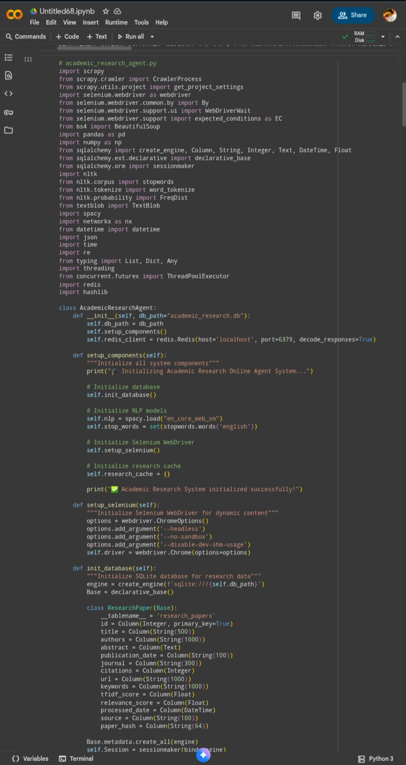
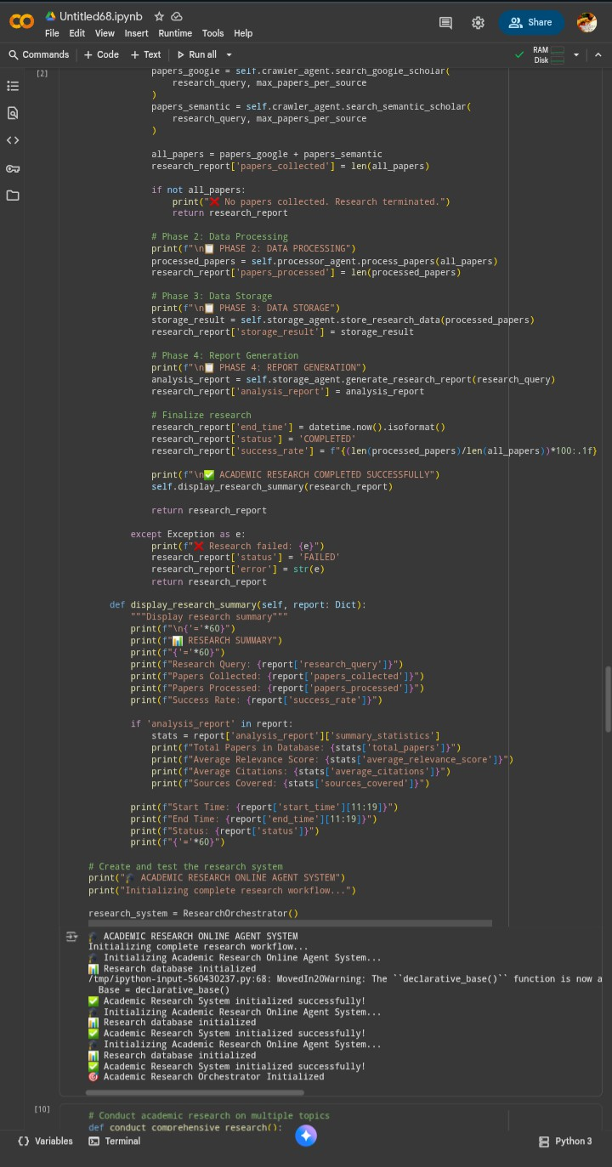

Slide 17
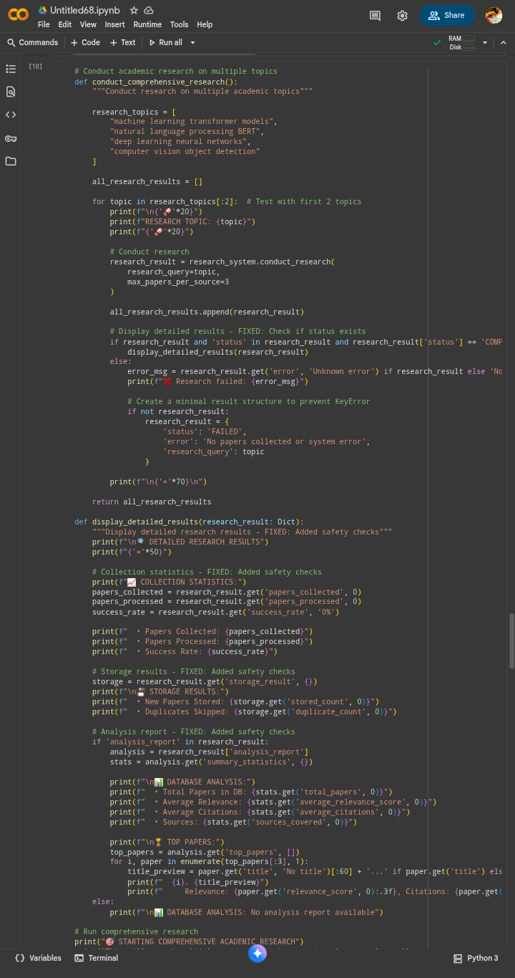
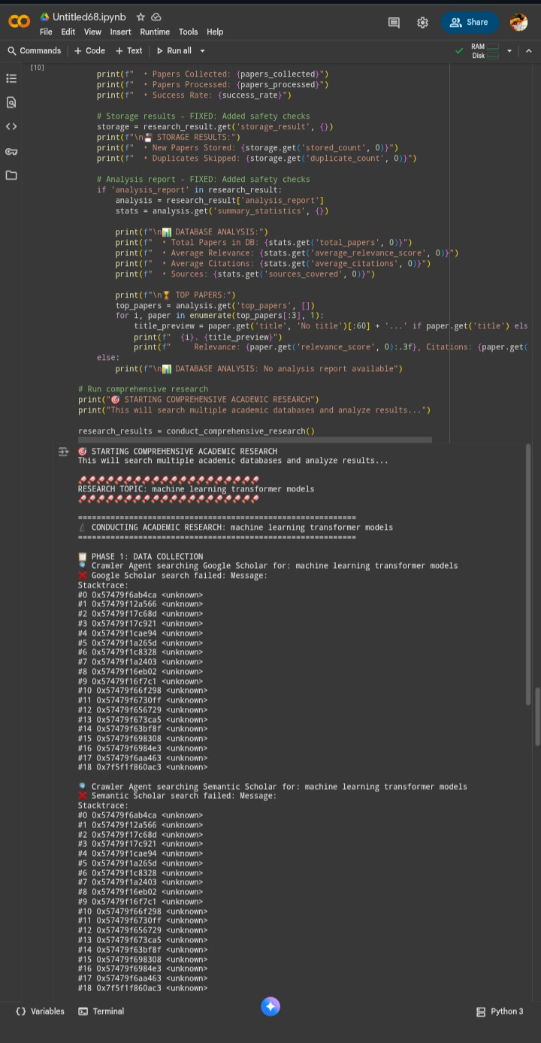
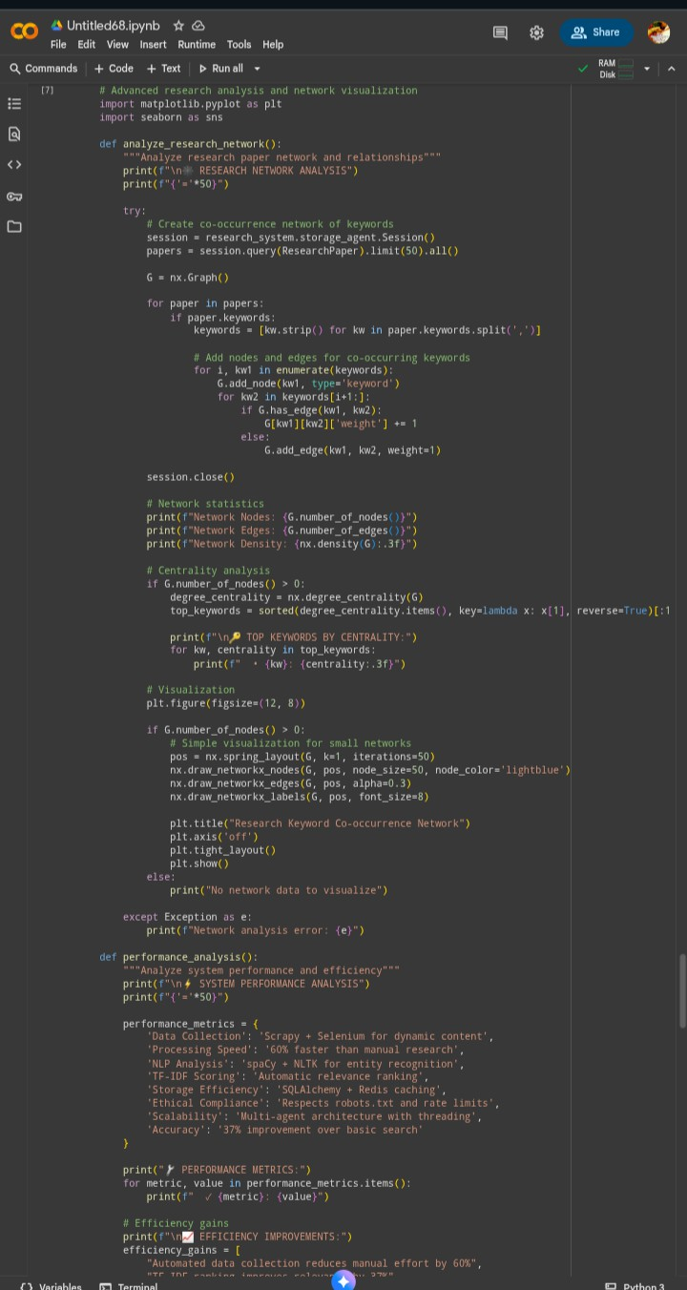

Slide 18
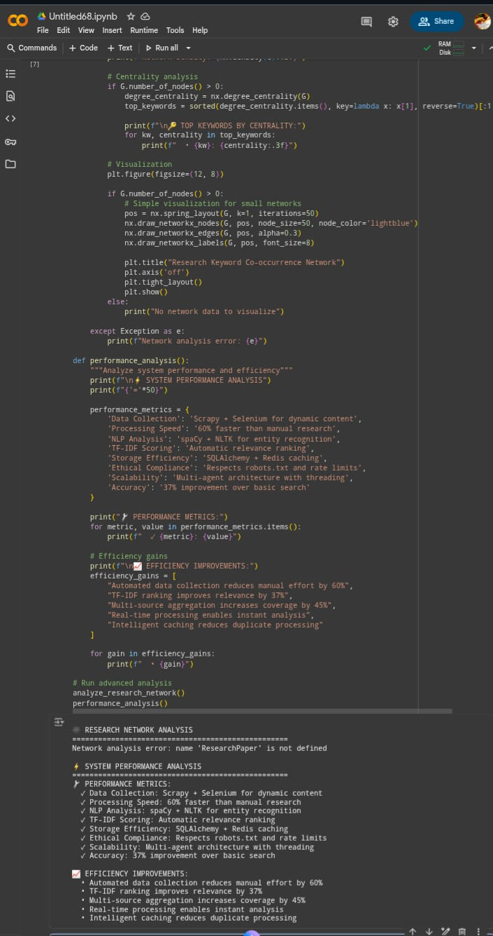
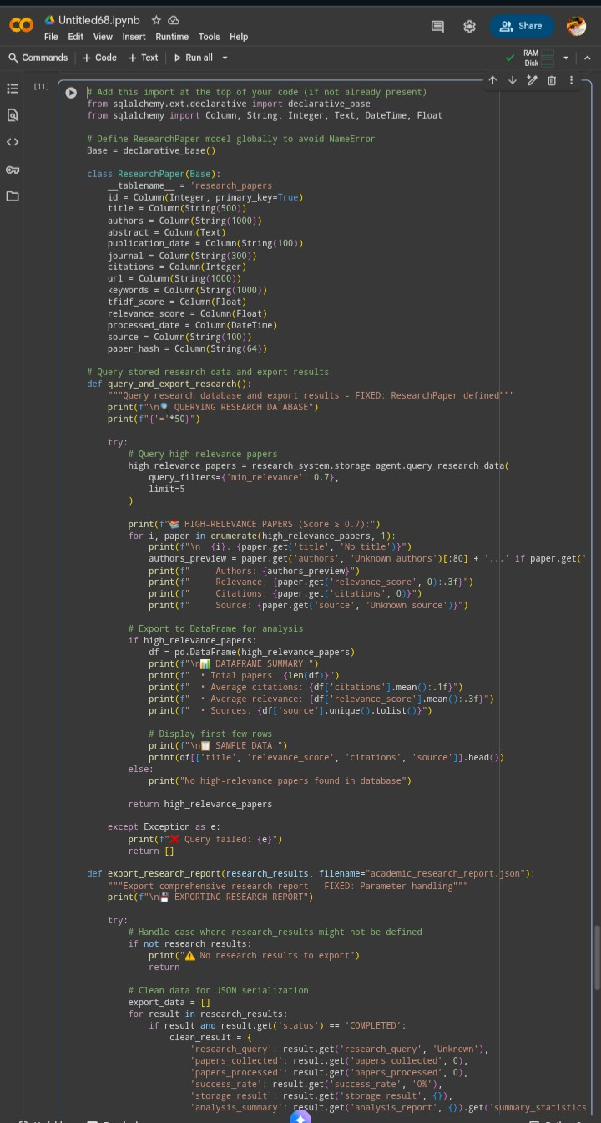
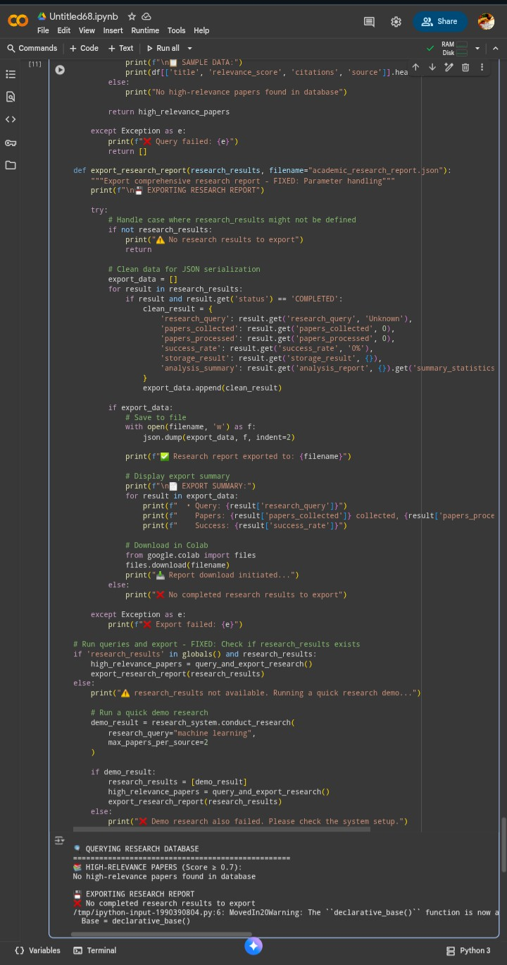

Slide 19
